Slide 2
Unit 5: Probability Concept and Random Numbers (7 hrs)
5.1 Stochastic System
5.2 Discrete and Continuous Probability Function
5.3 Random Numbers Versus Pseudo Random Numbers
5.4 Properties of Random Numbers
5.5 Random Number Generation Techniques
5.5.1 Linear Congruential Generator
5.5.2 Mixed Generator
5.5.3 Additive and Incremental Generator
5.6 Test for Randomness
5.6.1 Uniformity Test (KS Test, Chi Square Test)
5.6.2 Independence Test (Run Test (Above and Below, Up and Down, Lengths of Runs), Test for Auto Correlation, Gap Test, Poker Test)

Slide 3
Test for Randomness
Uniformity Test (Frequency Test)
Kolmogorov-Smirnov test (K-S Test): Compares the cumulative distribution function (CDF) of the observed data with the uniform distribution.
Chi-Square Test: Compares the observed frequency of numbers falling into bins with the expected frequency.
Independence Test
Runs Test: Checks for non-random sequences above or below the mean
Auto Correlation Test: Measures correlation between elements at fixed lags
Gap Test: Measures the number of values between repetitions of numbers in a certain range.
Poker Test

Slide 4
Independence Test
Sometime the random number generator passes the K-S test and Chi-square tests for uniformity, but the number generated my not be independent.
Hence there is need of independence test.
There are many methods to check the independence of generators.
Run test
Auto correlation test
Gap Test
Poker Test

Slide 5
Run test

Slide 6
Runs Test
Run Test Tests the run up and down or the runs above and below the mean by comparing the actual value to expected value.
The run test examines the arrangements of numbers in a sequence to test the hypothesis of independence.
A run is defined as a succession of similar events proceeded and followed by a different event.
The number of events that occur in the run is called Run-Length.

Slide 7
Runs Test
Example: Tossing coin
Consider the sequence of tossing a coin 10 times:
H, T, T, H, H, T, T, T, H, T
There are two possible concerns in run tests. They are:
Number of runs - Run-up and down & Runs above and below mean
Length of runs
No | Run Length | Run
1 | 1 | H
2 | 2 | T T
3 | 2 | H H
4 | 3 | T T T
5 | 1 | H
6 | 1 | T

Slide 8
Runs Test - Runs Up And Down

Slide 9
Runs Test - Runs Up And Down
Up run - Sequence of numbers each of which is succeeded by a larger number is called as up run.
Down run - Sequence of numbers each of which is succeeded by smaller number is called as down run.
If a number is followed by a larger number, then it denoted by ‘+’.
If followed by a smaller number, then by ‘-‘.

Slide 10
Runs Test - Runs Up And Down
If a sequence of number of too few runs, it is not likely a random sequence.
Example, 0.08, 0.18, 0.23, 0.36, 0.42, …., the sequence has only one run, i.e. an up run, so not likely a random sequence.
Also, if a sequence has too many runs, it is not likely to be random.
Example, 0.08, 0.93, 0.15, 0.96, 0.26, 0.84, 0.28, 0.79, 0.36, 0.57. it has total 9 runs, five up and four down, so it is not likely a random sequence.

Slide 11
Runs Test - Runs Up And Down
To illustrate the above, consider the sequence of numbers
0.87 0.15 0.23 0.45 0.69 0.32 0.30 0.19 0.24 0.18 0.65 0.82 0.93 0.22
The up run and down run are marked as
-0.87 +0.15 +0.23 +0.45 -0.69 -0.32 -0.30 +0.19 -0.24 +0.18 +0.65 +0.82 -0.93 +0.22
The sequence of ‘+’ and ‘-‘are:
- + + + - - - + - + + + -
It has 7 runs, first run of length one, second run of length three, third run of length 3, and fourth run with one, fifth run with one, sixth run with three and seventh run with one. There are three up runs and four down runs.

Slide 12
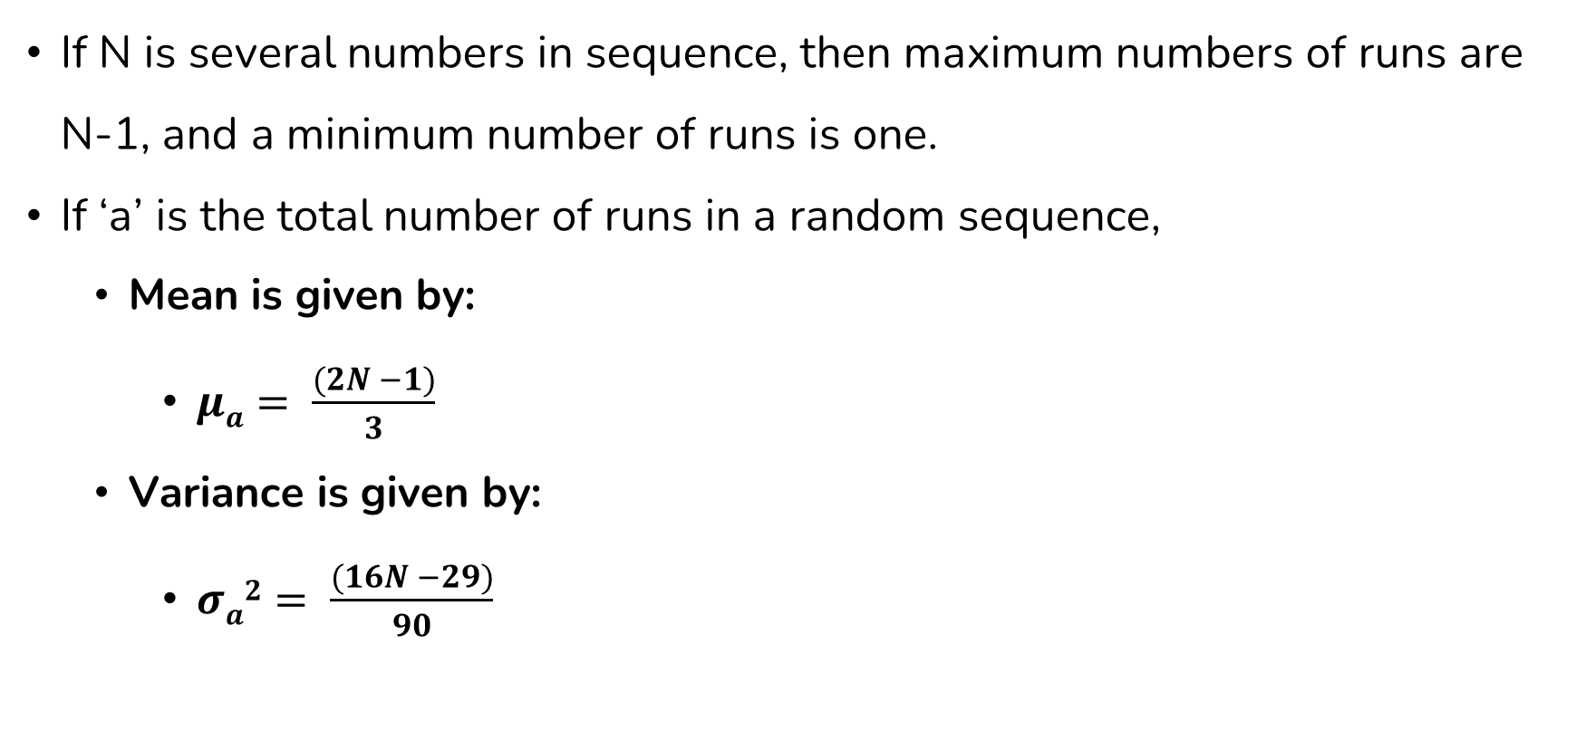
Runs Test - Runs Up And Down
If N is several numbers in sequence, then maximum numbers of runs are N-1, and a minimum number of runs is one.
If ‘a’ is the total number of runs in a random sequence,
Mean is given by:
$μa= \frac{(2N −1)}{3}$
Variance is given by:
$σa2= \frac{(16N −29)}{90}$

Slide 13
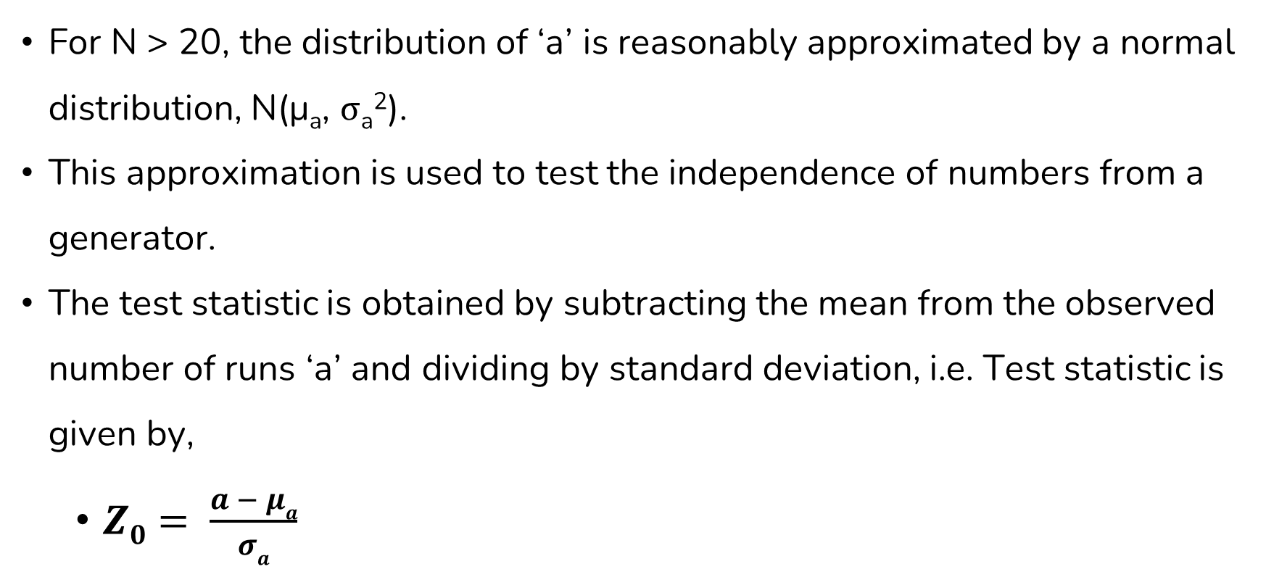
Runs Test - Runs Up And Down
For N > 20, the distribution of ‘a’ is reasonably approximated by a normal distribution, N(μ_{a}, σ_{a}²).
This approximation is used to test the independence of numbers from a generator.
The test statistic is obtained by subtracting the mean from the observed number of runs ‘a’ and dividing by standard deviation, i.e. Test statistic is given by,
$Z0= \frac{a − μa}{σa}$

Slide 14

Runs Test - Runs Up And Down
Substituting μ_{a} and σ_{a} in above equation, we get:
$Z0= \frac{a −[\frac{\left(2N −1\right)}{3}]}{\sqrt{[\frac{\left( 16N −29\right)}{90} ]}}$

Slide 15
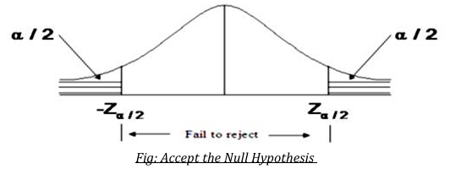
Runs Test - Runs Up And Down
The null hypothesis is accepted when –Z_{α/2} ≤ Z₀ ≤ Z_{α/2}, where α is the level of significance. The critical values and rejection region is shown in the figure below.

Slide 16
Runs Test - Runs Up And Down Numerical
Example: Based on the runs up and runs down, determine whether the following sequence of 40 numbers is such that the hypothesis of independence can be rejected where α = 0.05
.41 .68 .89 .94 .74 .91 .55 .62 .36 .27
.19 .72 .76 .08 .54 .02 .01 .36 .16 .28
.18 .01 .95 .69 .18 .47 .23 .32 .82 .53
.31 .42 .73 .04 .83 .45 .13 .57 .63 .29

Slide 17
Runs Test - Runs Up And Down Numerical
Solution,
Assigning a “+” or “-” in the number based on whether they are followed by a larger or smaller number.
The last number is followed by no events so it will neither get a “+ “nor a “-“.
The sequence of runs up and runs down is below.
+ + + - + - + - - - + + - + - - + - + - - + - - + - + + - - + + - + - - + + -
Total number of runs in this sequence, a=26.

Slide 18
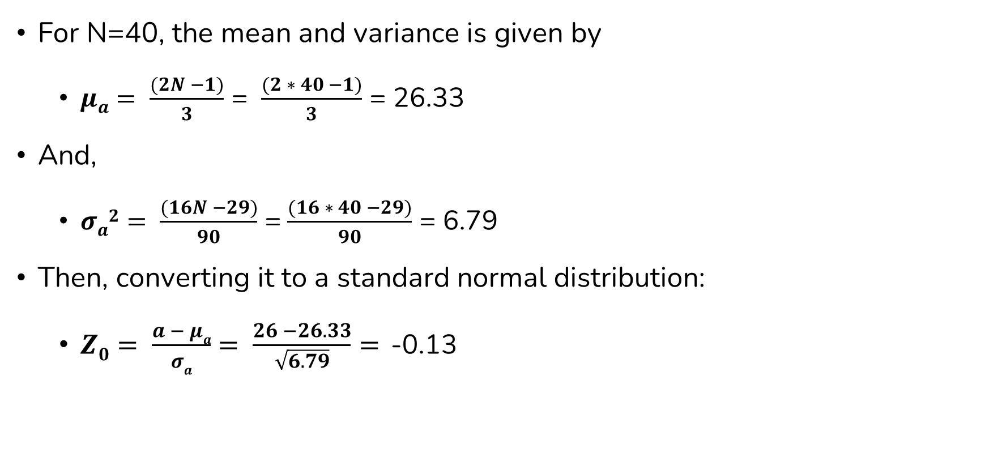
Runs Test - Runs Up And Down Numerical
For N=40, the mean and variance is given by
$μa= \frac{(2N −1)}{3}$ = $\frac{(2 ∗ 40 −1)}{3}$ = 26.33
And,
$σa2= \frac{(16N −29)}{90}$ =$\frac{(16 ∗ 40 −29)}{90}$ = 6.79
Then, converting it to a standard normal distribution:
$Z0= \frac{a − μa}{σa}$ $= \frac{26 −26.33}{\sqrt{6.79}}=$-0.13

Slide 19
Runs Test - Runs Up And Down Numerical
Now, the critical value , Z_{α/2} = Z_{0.025} = 1.96 (from z score table).
Since Z₀ >=-Z_{α/2}, and Z₀<=Z_{α/2} , so the independence of the numbers can’t be rejected on the basis of this test. i.e. null hypothesis of independence can’t be rejected.

Slide 20
Runs Test - Runs Up And Down Question
Consider the 50 two-digit values.
0.34 0.9 0.25 .89 .87 .76 .79 .96 .64 .99 .77 .7 .47 .67 .3 .17 .56 .79 .82 .71 .23 .56 .99 .19 .17 .99 .82 .37 .46 .51 .54 .05 .72 .01 .43 .56 .81 .06 .97 .39 .84 .3 .18 .24 .26 .4 .97 .88 .64
Based upon run up and down, determine whether the hypothesis of independence can be rejected, where α = 0.05.

Slide 21
Runs Test - Runs Above And Below The Mean

Slide 22
Runs Test - Runs Above And Below The Mean
Runs are described with above/below the mean value.
A ‘+’ sign is used to indicate above mean and ‘-‘ sign for below the mean.
To illustrate the above, consider the sequence of 2-digit random numbers
0.40 0.84 0.75 0.18 0.13 0.92 0.57 0.77 0.30 0.71 0.42 0.05 0.78 0.74 0.68 0.03 0.18 0.51 0.10 0.37

Slide 23
Runs Test - Runs Above And Below The Mean
Mean = (0.99+0.00)/2 = 0.495
The runs above and below mean are marked as
-0.40 +0.84 +0.75 -0.18 -0.13 +0.92 +0.57 +0.77 -0.30 +0.71 -0.42 -0.05 +0.78 +0.74 +0.68 -0.03 -0.18 +0.51 -0.10 -0.3
The sequence of ‘+’ and ‘-‘are
- + + - - + + + - + - - + + + - - + - -
There are 11 runs, of which 5 are above mean and 6 runs below mean.

Slide 24
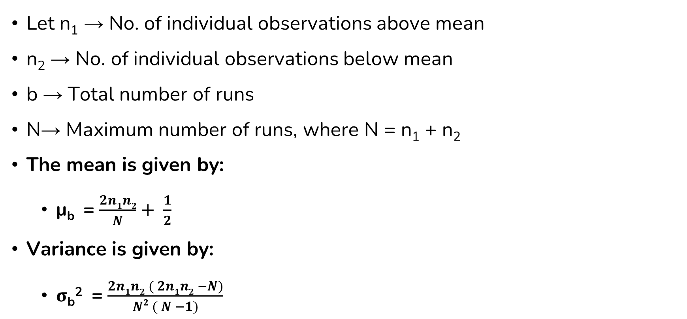
Runs Test - Runs Above And Below The Mean
Let n₁ → No. of individual observations above mean
n₂ → No. of individual observations below mean
b → Total number of runs
N→ Maximum number of runs, where N = n₁ + n₂
The mean is given by:
μ_{b} = $\frac{2n1n2}{N}+ \frac{1}{2}$
Variance is given by:
σ_{b}² = $\frac{2n1n2 ( 2n1n2 −N)}{N2 ( N −1)}$

Slide 25
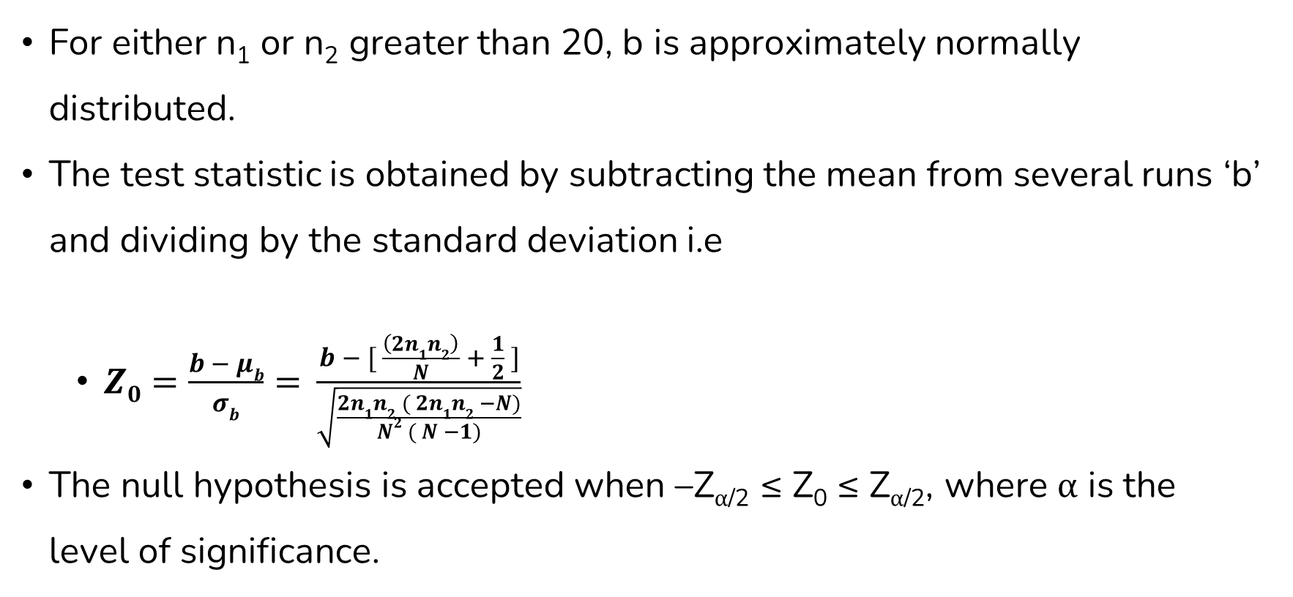
Runs Test - Runs Above And Below The Mean
For either n₁ or n₂ greater than 20, b is approximately normally distributed.
The test statistic is obtained by subtracting the mean from several runs ‘b’ and dividing by the standard deviation i.e
$Z0=\frac{b − μb}{σb}= \frac{b − [ \frac{\left(2n1n2\right)}{N} + \frac{1}{2} ]}{\sqrt{\frac{2n1n2 ( 2n1n2 −N)}{N2 ( N −1)}}}$
The null hypothesis is accepted when –Z_{α/2} ≤ Z₀ ≤ Z_{α/2}, where α is the level of significance.

Slide 26
Runs Above And Below The Mean Example
Based on runs above and below mean, determine whether the following sequence of 40 numbers is such that the hypothesis of independence can be rejected or accepted where α = 0.05.
.41 .68 .89 .94 .74 .91 .55 .62 .36 .27
.19 .72 .76 .08 .54 .02 .01 .36 .16 .28
.18 .01 .95 .69 .18 .47 .23 .32 .82 .53
.31 .42 .73 .04 .83 .45 .13 .57 .63 .29

Slide 27
Runs Above And Below The Mean Example
Solution:
Mean= 0.495
The sequence of runs above and below mean is as follows:
- + + + + + + + - -
- + + - + - - - - -
- - + + - - - - + +
- - + - + - - + + -

Slide 28

Runs Above And Below The Mean Example
n₁ = 18, n₂ = 22
N = n₁ + n₂ = 40
b = 17
μ_{b} = $\frac{2n1n2}{N}+ \frac{1}{2}$ = $\frac{2 ∗18 ∗22}{40}+ \frac{1}{2}$ = 20.3
σ_{b}² = $\frac{2 ∗18 ∗22 ( 2 ∗18 ∗22 −40)}{402 ( 40 −1)}$ = 9.54
Since n₂ > 20, normal approximation is accepted.

Slide 29
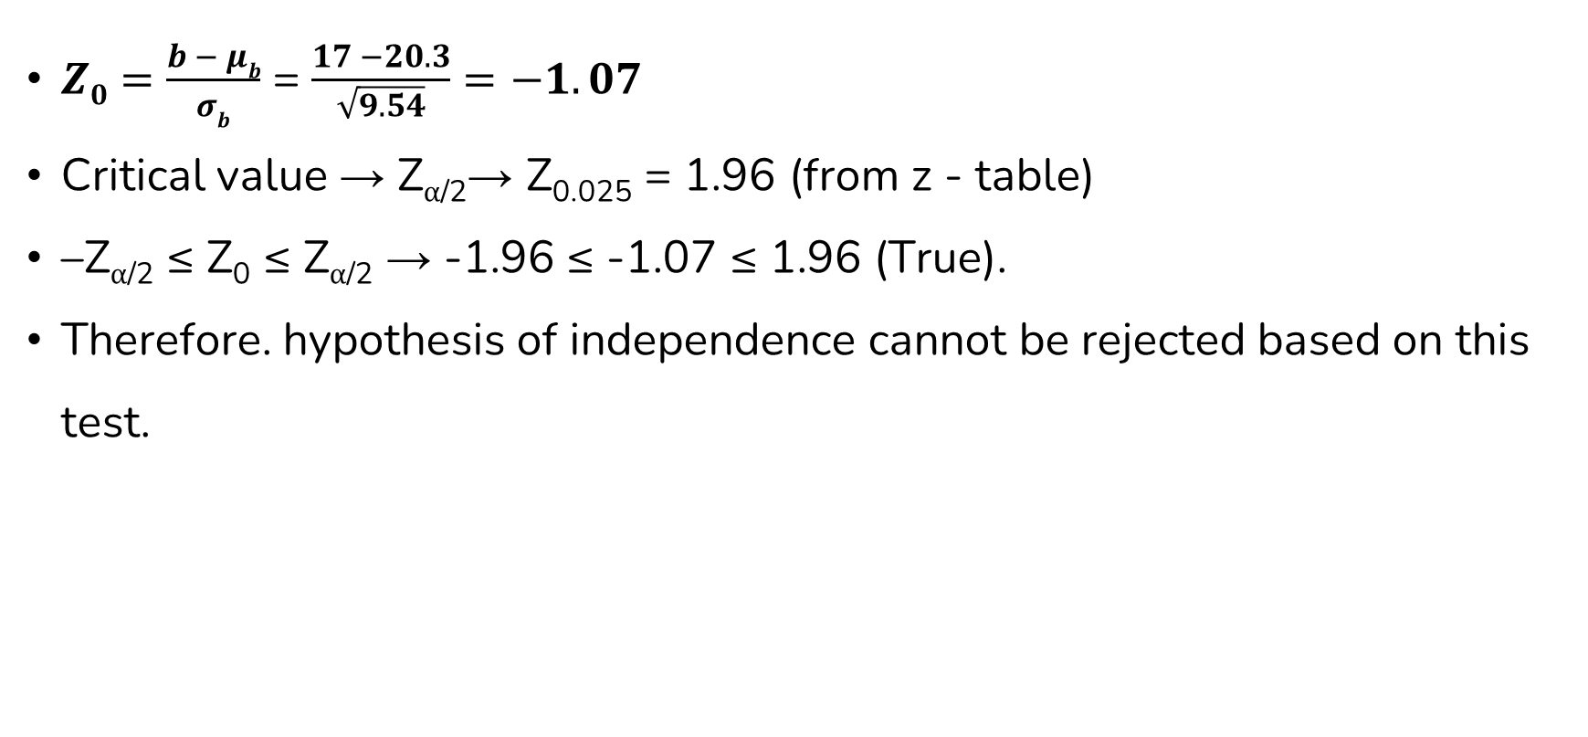
Runs Above And Below The Mean Example
$Z0=\frac{b − μb}{σb}$ = $\frac{17 −20.3}{\sqrt{9.54}}=−1.07$
Critical value → Z_{α/2}→ Z_{0.025} = 1.96 (from z - table)
–Z_{α/2} ≤ Z₀ ≤ Z_{α/2} → -1.96 ≤ -1.07 ≤ 1.96 (True).
Therefore. hypothesis of independence cannot be rejected based on this test.

Slide 30
Runs Test - Length Of Runs

Slide 31
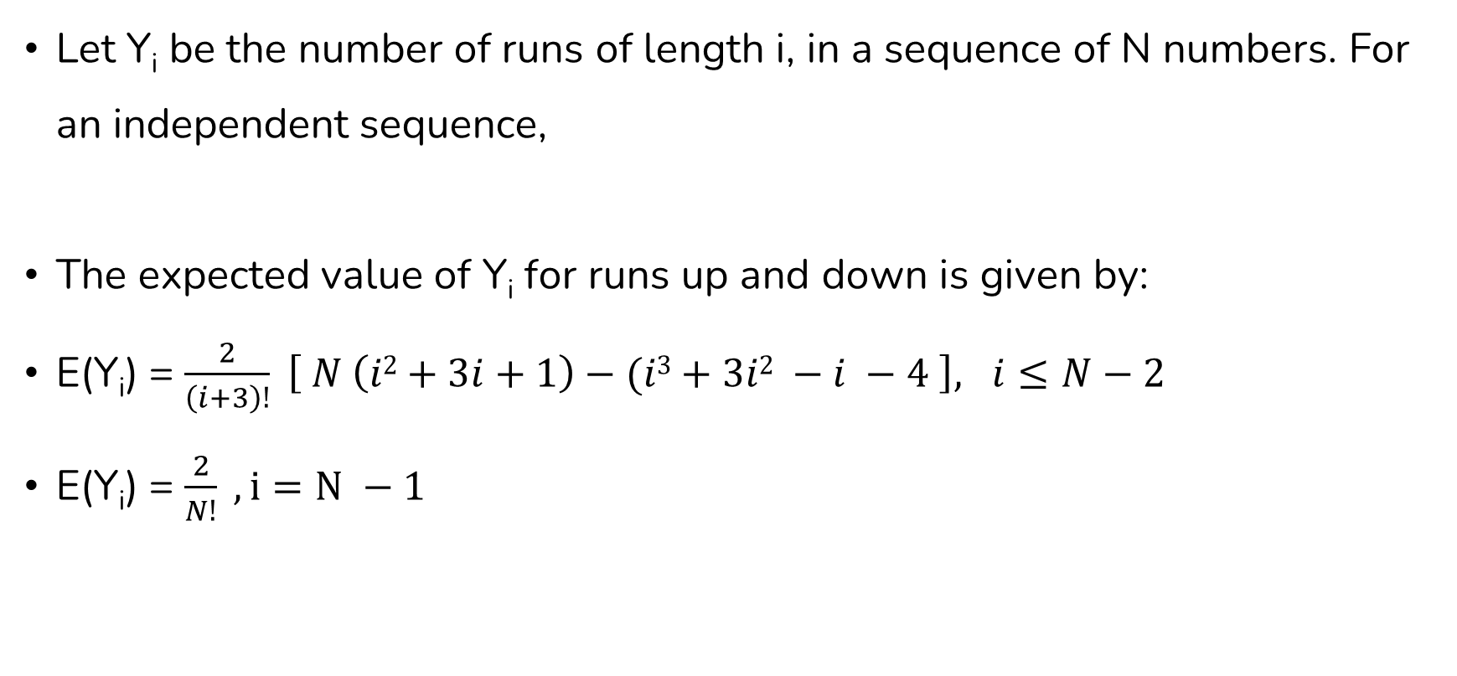
Runs Test - Length Of Runs
Let Y_{i} be the number of runs of length i, in a sequence of N numbers. For an independent sequence,
The expected value of Y_{i} for runs up and down is given by:
E(Y_{i}) = $\frac{2}{\left(i+3\right)!} \left[ N \left(i2+3i+1\right)−(i3+3i2 −i −4 \right], i≤N−2$
E(Y_{i}) = $\frac{2}{N!} , i=N −1$

Slide 32


Runs Test - Length Of Runs
The expected value of Y_{i} for runs above and below mean is given by:
E(Y_{i}) = $\frac{Nwi}{E(I)} , N>20$
Where,
And E(I), the approximate expected length of a run is given by:
E(I) = $\frac{n1}{n2}+\frac{n2}{n1}, N>20$

Slide 33
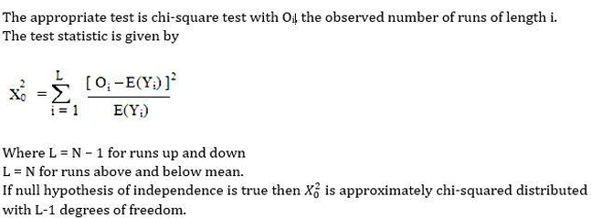

Runs Test - Length Of Runs
The approximate expected total number of runs (of all lengths) E(A) is given by:
E(A) = $\frac{N}{E(I)}, N>20$

Slide 34
Length Of Runs Example
Given the sequence of numbers, can the hypothesis that the numbers are independent be rejected on the basis of length of runs up and down at α = 0.05?
.30 .48 .36 .01 .54 .34 .96 .06 .61 .85
.48 .86 .14 .86 .89 .37 .49 .60 .04 .83
.42 .83 .37 .21 .90 .89 .91 .79 .57 .99
.95 .27 .41 .81 .96 .31 .09 .06 .23 .77
.73 .47 .13 .55 .11 .75 .36 .25 .23 .72
.60 .84 .70 .30 .26 .38 .05 .19 .73 .44

Slide 35
Length Of Runs Example
Solution:
N = 60
The sequence of + and – are as follows
+ - - + - + - + + -
+ - + + - + + - + -
+ - - + - + - - + -
- + + + - - - + + -
- - + - + - - - + -
+ - - - + - + + -

Slide 36
Length Of Runs Example
The length of runs in the sequence is as follows:
1, 2, 1, 1, 1, 1, 2, 1, 1, 1, 2, 1, 2, 1, 1, 1, 1, 2, 1, 1,
1, 2, 1, 2, 3, 3, 2, 3, 1, 1, 1, 3, 1, 1, 1, 3, 1, 1, 2, 1
Calculate O_{i}
Run Length, i | 1 | 2 | 3 | 4
Observed Length, O_{i} | 26 | 9 | 5 | 0

Slide 37
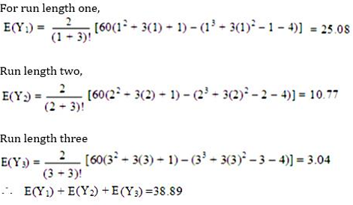
Length Of Runs Example
The expected value of Yi,

Slide 38
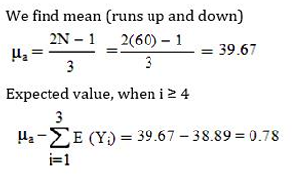
Length Of Runs Example

Slide 39
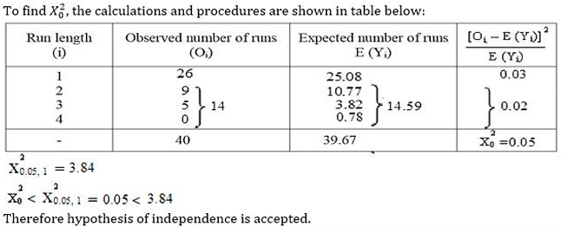
Length Of Runs Example

Slide 40
Length Of Runs Example
Given the sequence of numbers can the hypothesis that the numbers are independent be rejected on the basis of length of runs above and below mean at α = 0.05?
.30 .48 .36 .01 .54 .34 .96 .06 .61 .85
.48 .86 .14 .86 .89 .37 .49 .60 .04 .83
.42 .83 .37 .21 .90 .89 .91 .79 .57 .99
.95 .27 .41 .81 .96 .31 .09 .06 .23 .77
.73 .47 .13 .55 .11 .75 .36 .25 .23 .72
.60 .84 .70 .30 .26 .38 .05 .19 .73 .44

Slide 41
Length Of Runs Example
Solution,
N = 60
Mean = (0.99+0.00)/2 = 0.495
The sequence of + and – are as follows:
- - - - + - + - + +
- + - + + - - + - +
- + - - + + + + + +
+ - - + + - - - - +
+ - - + - + - - - +
+ + + - - - - - + -

Slide 42
Length Of Runs Example
n₁ = 28
n₂ = 32
N = n₁ + n₂ = 60
The length of runs in the sequence is as follows:
4, 1, 1, 1, 1, 2, 1, 1, 1, 2, 2, 1, 1, 1, 1, 1, 2, 7, 2, 2, 4, 2, 2, 1, 1, 1, 3, 4, 5, 1, 1
Calculate O_{i}
Run Length, i | 1 | 2 | 3 | >=4
Observed Length, O_{i} | 17 | 8 | 1 | 5

Slide 43
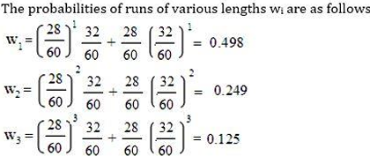
Length Of Runs Example

Slide 44
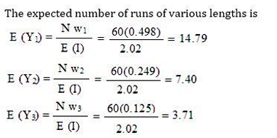
Length Of Runs Example

Slide 45
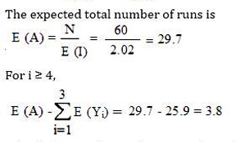
Length Of Runs Example

Slide 46
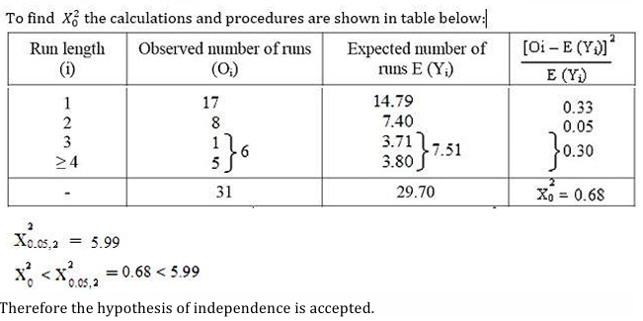
Length Of Runs Example

Slide 47
Auto Correlation Test

Slide 48
Auto Correlation Test
The uniformity test of random numbers is only a necessary test for randomness, not a sufficient one.
A sequence of numbers may be perfectly uniform and still not random.
For example, the sequence
0.1, 0.2, 0.3, 0.4, 0.5, 0.6, 0.7, 0.8, 0.9, 0.1, 0.2, 0.3, …, …
would give a perfectly uniform distribution with chi-square value perfectly as zero.

Slide 49
Auto Correlation Test
But the sequence can be no means be regarded as random.
The numbers are not independent as the occurrence of one number say 0.3 decides the next, which is to be 0.4, etc.
This defect is called serial autocorrelation of an adjacent pair of numbers.

Slide 50
Auto Correlation Test
The chi-square test for serial autocorrelation makes use of a 10 * 10 matrix.
The 10 class describe in the uniformity test are represented both along the rows and columns.
If the classes are to be represented on a bar chart, 100 bars, one for each cell of a matrix will be required.
To reduce the number of groups instead of 10 random numbers are divided into a smaller number of a class as 3 or 4.

Slide 51
Auto Correlation Test
Three class will be as:
Less than or equal to 0.33
Less than or equal to 0.67
Less than or equal to 1.0
With three classes in a row and three classes in a column, there will be 9 cells.

Slide 52
Auto Correlation Test Example
Let us consider the following random numbers:
49, 95, 82, 19, 41, 31, 12, 53, 62, 40, 87, 83,
26, 01, 91, 55, 38, 75, 90, 35, 71, 57, 27, 85,
52, 08, 35, 57, 88, 38, 77, 86, 29, 18, 09, 96,
58, 22, 08, 93, 85, 45, 79, 68, 20, 11, 78, 93,
21, 13, 06, 32, 63, 79, 54, 67, 35, 18, 81, 14,
62, 13, 76, 74, 76, 45, 29, 36, 80, 78, 95, 25, 52
Determine whether the hypothesis of independence can be rejected, where α = 0.05

Slide 53
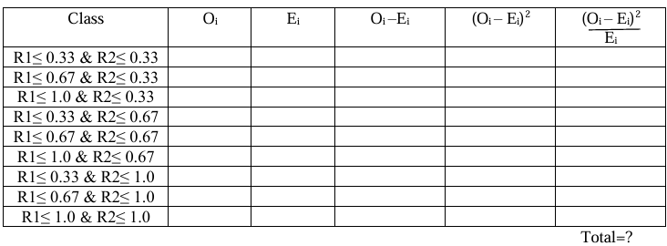
Auto Correlation Test Example
Solution,
These N = 73 random numbers, giving (N-1)=72 pairs, are grouped in 9 classes with expectation E_{i} = N/n = 72/9 ~ 8

Slide 54
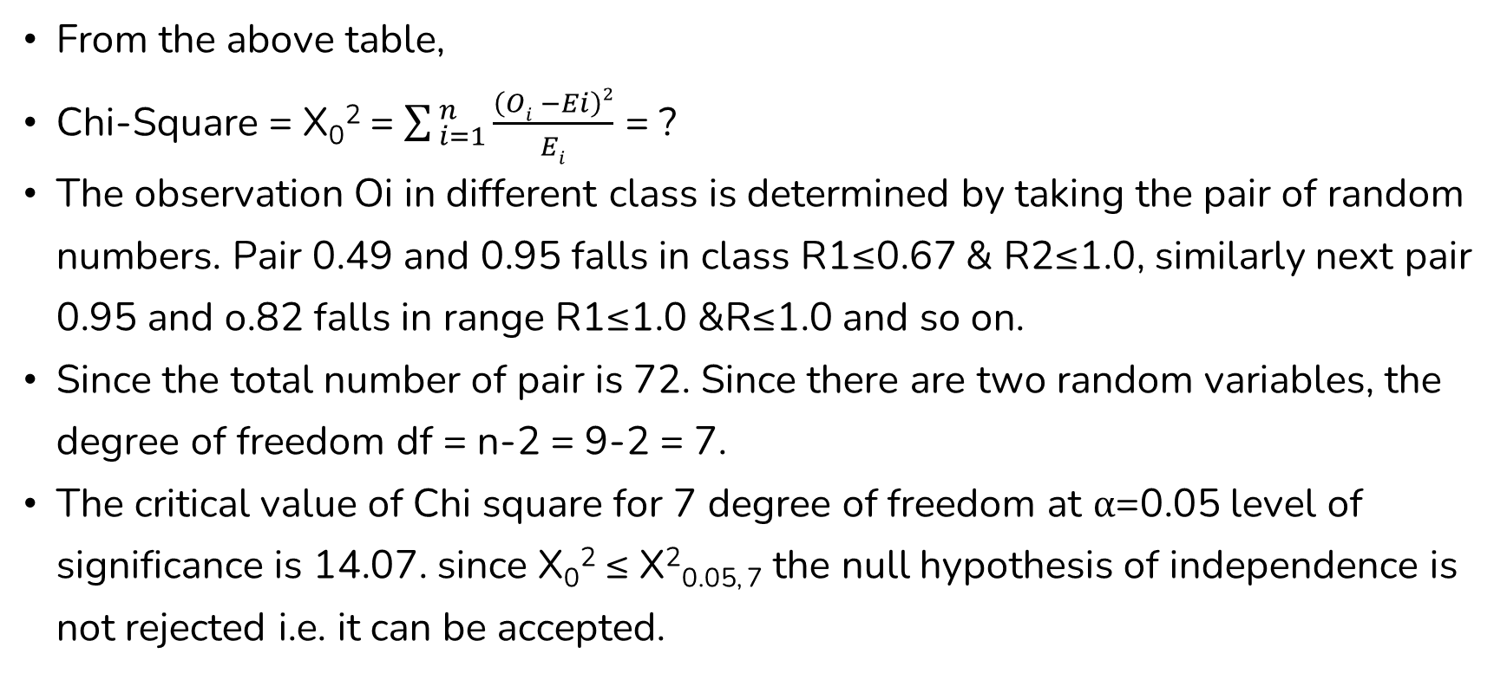
Auto Correlation Test Example
From the above table,
Chi-Square = X₀² = $\sum_{ i=1}^{ n}{\frac{\left(Oi −Ei\right)2}{Ei}}$ = ?
The observation Oi in different class is determined by taking the pair of random numbers. Pair 0.49 and 0.95 falls in class R1≤0.67 & R2≤1.0, similarly next pair 0.95 and o.82 falls in range R1≤1.0 &R≤1.0 and so on.
Since the total number of pair is 72. Since there are two random variables, the degree of freedom df = n-2 = 9-2 = 7.
The critical value of Chi square for 7 degree of freedom at α=0.05 level of significance is 14.07. since X₀² ≤ X²_{0.05, 7} the null hypothesis of independence is not rejected i.e. it can be accepted.

Slide 55
End of Lecture 17

Slide 56
Simulation Language GPSS

